Slide 1
PUBLICAI FOUNDRY
Creating Safe AI Agents for your needs
MISTRAL AI ‘26 - SYDNEY
TEAM ( ) - HARSHITH, PASTA, SHYAM

Slide 2


WHAT WE’RE
ABOUT
We don’t fix problems. We create stuff that fix the problems.
We don’t build agents. We build stuff that build the agents.
This is PublicAI Foundry – create an agent for whatever you need, regardless of your background in tech.

Slide 3

WHAT COULD REBECCA BENEFIT FROM?
Create a personalised housing search assistant
Form a social housing waitlist navigator
Application automation and document assistant
MEET REBECCA
Meet Rebecca, a 25-year-old UNSW grad with a degree, a job, and a dream of living in Sydney. But like 61,000+ others, she’s stuck on a 15-month waitlist for social housing, drowning in confusing applications, scam listings, and sky-high rents. She doesn’t know where to turn, who to trust, or how to break the cycle of rejection and stress.
Notes:
Solution A - The agent can scrape verified rental platforms and government housing portals.
Filter options by budget, location, amenities, and eligibility for social housing.
Provide a ranked shortlist of suitable options.
Solution B - Step-by-step guidance through social housing applications, including required documents.
Eligibility checker to see which housing programs she qualifies for.
Tracking system for application status and reminders for follow-ups.
Solution C -
Pre-fill forms where possible using stored info.
Keep digital copies of ID, payslips, and reference letters ready.
Auto-submit applications to multiple platforms with her approval.

Slide 4
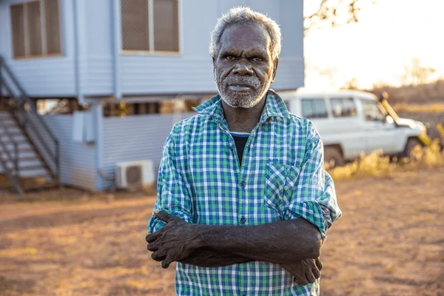
Jarrah is a 58-year-old Aboriginal living in regional NSW. He’s been feeling unwell for months, but the nearest specialist is hours away. He also has multiple food allergies and, being away from home, is uncertain about what he can safely eat. As an Aboriginal, Jarrah is three times more likely to develop chronic conditions, yet faces longer wait times for care, with elective surgeries taking a median of 322 days. He doesn’t know how to manage costs or access the right support before his condition worsens.
WHAT COULD JARRAH BENEFIT FROM?
AI Health Triage & Risk Prioritisation
Culturally-Aware Care Connector
Regional Access Optimiser
AND MEET JARRAH
Notes:
Solution A: Jarrah inputs his symptoms, medical history, and risk factors into the agent. The system:
Assesses urgency using evidence-based triage logic
Flags high-risk indicators (e.g., chronic disease markers common in Aboriginal populations)
Recommends the appropriate next step: ED, GP, telehealth, or community clinic
Generates a structured symptom summary he can show a doctor
Impact: Reduces dangerous delays, prevents unnecessary emergency visits, and ensures Jarrah is prioritised appropriately within an overloaded system.
Solution B: The agent prioritises:
Aboriginal Community Controlled Health Services (ACCHS)
Indigenous-led clinics
Providers trained in culturally safe practice
Services eligible under Close the Gap initiatives
It also:
Explains care rights clearly
Identifies bulk-billing Aboriginal services
Flags programs designed specifically for First Nations patients
Impact: Builds trust, improves adherence to treatment, and reduces systemic barriers that contribute to the 6.8-year life expectancy gap.
This is not just access — it’s culturally safe access.
Solution C:
Because Jarrah lives in regional NSW, access isn’t just about availability — it’s about geography.
The agent:
Maps nearby specialists, mobile clinics, telehealth providers
Compares public vs private wait times
Identifies hospitals with shorter elective surgery queues
Notifies Jarrah of cancellations or earlier openings
Optimises travel time vs urgency
It may even suggest:
Telehealth first → in-person specialist second
Alternative regional hubs with shorter delays
Impact: Transforms regional disadvantage into navigable data. Jarrah doesn’t just wait — he strategises.

Slide 5
WHAT DO REBECCA AND JARRAH HAVE IN COMMON?
1. COMPLEX PROCESSES
solved by our agent guiding step-by-step through applications and referrals according to their needs
2. NEED FOR TRUSTED GUIDANCE
solved by personalised AI support and culturally aware recommendation; all from trusted sources and latest trends
3. PERSONALIZED CHOICES
solved by tailoring agents to their need and wants and adding the knowledge base that they look for
4. LIMITED ACCESS
solved by waitlist tracking, regional optimisation, and alternative pathways

Slide 6
HOW DOES OUR PUBLICAI FOUNDRY WORK?
FACT #1
FACT #2
FACT #3
Regardless of your background in tech, we’re empowering small businesses as well as common people to help create AI Agents and use them for their needs.
100% No-Code
Less than 60s to your first AI Agent
Highly Customizable
Set of pre-made templates
User can talk or chat their way to create agents or we also have the option to build it manually with a 6-step guided process.
Highly customizable to demographics, personal history, guardrailing, external tools, and even an entire knowledge base!
Read to deploy, the moment you create!
Access your agents through our playground to test or use them with various LLM models (supporting only Mistral.AI models currently)
At your ease access on whatsapp, just send your credentials and access your agents on-the-go for your needs

Slide 7

WHAT SETS US APART?
Accessible
Conversation-Based
Personalizable
Unlike standard AI models, it doesn’t just answer questions it lets you build specialised agents for housing, healthcare, legal aid, and more.
Users don’t design systems; they describe problems. The platform understands the need and turns it into a working AI solution through natural conversation.
Each solution can be tailored to a person, community, process, or use case. It’s not one-size-fits-all bots, but purpose-built intelligence.
Self Architecting
Research Guided
Multimodal
From a single conversation, the system automatically designs the full AI structure: the agents, roles, workflows, tools, memory and coordination logic.
Every solution is informed by deep research and structured knowledge, so systems are built on understanding, not guesswork.
Agents can be built and accessed via both voice and chat, making AI interaction and creation natural, immediate, and inclusive for all users.

Slide 8
WHAT IS PUBLICAI FOUNDRY’S POTENTIAL IMPACT?
Assist +67,000 individuals across New South Wales in dealing with waitlists for social housing
PUBLICAI FOUNDRY has the power to transform how people access essential services across NSW. By creating personalised agents, it can help tens of thousands of residents navigate social housing, healthcare, legal aid, education, and professional opportunities more efficiently.
Potentially shorten referral and wait times for millions of GP and specialist visits for 30-40% of patients.
Could help 570,000+ NSW residents access legal aid faster by automating eligibility checks, intake forms, and referral pathways.
Bridges gaps for regional populations (~34% of NSW residents) and 1 in 3 non-English speaking households, making complex systems navigable.
Reduces skills gaps by connecting employers with qualified candidates, addressing recruitment difficulties reported by 77% of NSW businesses
Can triage and prioritise care for 100,000+ elective surgery patients, helping reduce the dangerous 322-day median waitlist.
Helps bridge the projected shortfall of 85,000 digital workers by 2030, connecting learners to training and employment.

Slide 9
CHANGE
TODAY
WITH
US.
THANK YOU!

